Slide 1
A Framework for MIMO Operation over mmWave Links
Authors:
Name | Affiliation | Address | Phone | Email
Alireza Tarighat | Broadcom |  |  | atarighat@broadcom.com
Payam Torab | Broadcom |  |  | ptorab@broadcom.com
Brima Ibrahim | Broadcom |  |  | brima@broadcom.com
Vipin Aggarwal | Broadcom |  |  | vaggarwa@broadcom.com
Vinko Erceg | Broadcom |  |  | verceg@broadcom.com

Slide 2
Contents
mmWave MIMO for NG60
Possible MIMO scenarios
  SVD multiplexing
  Multi-array beamforming
  Spatial aggregation
  Multi-array diversity
Impact of phase noise on SVD multiplexing
Conclusions

Slide 3
Applicability of MIMO to mmWave
A 2x2 mmWave system deploys 2 TX arrays and 2 RX arrays.
  Each array may have N elements, but only two data feeds are available.
Each array has a programmable phase shifter that can be leveraged to change the MIMO channel seen by the 2x2 system.
  A major difference with sub-5GHz systems where omni elements are used.
  Additional knob available through changing array patterns.
2x2 MIMO
RF TRX
RF TRX
2x2 MIMO
RF TRX
RF TRX

Slide 4
Scenario 1: SVD Multiplexing (SM)
Form a 2x2 MIMO System
Apply SVD with/without waterfilling
Due to narrow beam patterns, the propagation will look like a LOS (AWGN) MIMO channel.
Can we expect a significant multiplexing gain in LOS (AWGN) MIMO channels?
RF TRX
RF TRX
2-stream Encoder
SVD Multiplexing
2-stream Decoder
SVD De-Multiplexing
RF TRX
RF TRX

Slide 5

Scenario 1: SVD Multiplexing (SM)
Two example usage cases
  High cross-interference between the streams (LOS MIMO & AWGN MIMO scenarios)
These two scenarios can be common in outdoor deployments.
Device
LOS
Device
Device
Device
Blocker
Reflector
Reflector

Slide 6





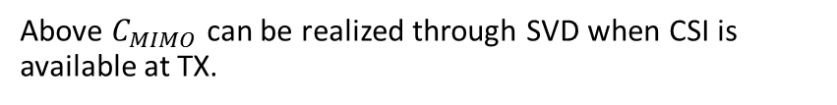


Scenario 1: SVD Multiplexing (SM)
SISO Capacity
x1
1
y1
$$C_{SISO(P)}=log(1+\frac{P}{N})$$
TX Power: P
Line-of-Sight MIMO Capacity
$$1e^{jφ_{11}}$$
y1
$$C_{MIMO}=\max_{R_{x}:Tr\left(R_{x}\right)=2P}{log\left(det (I+\frac{HR_{x}H^{∗}}{N})\right)}$$
x1
$$ke^{jφ_{12}}$$
$$HH^{∗}=\left[\begin{matrix}1+k^{2} & k\left(e^{j(+φ_{11}−φ_{21})}+e^{j(+φ_{12}−φ_{22})}\right) \\ k\left(e^{j(−φ_{11}+φ_{21})}+e^{j(−φ_{12}+φ_{22})}\right) & 1+k^{2}\end{matrix}\right]$$
x2
$$ke^{jφ_{21}}$$
y2
$$1e^{jφ_{22}}$$
Above $C_{MIMO}$ can be realized through SVD when CSI is available at TX.

Slide 7
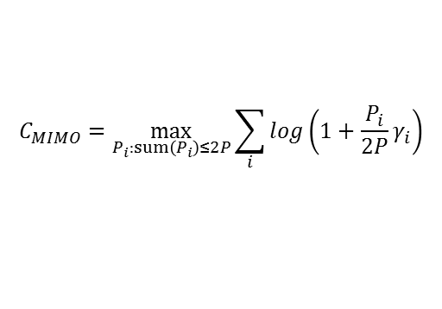
Scenario 1: SVD Multiplexing (SM)
MIMO capacity will depend on the following value:
MIMO capacity without waterfilling:
MIMO capacity with waterfilling
$$φ_{d}= +φ_{11}−φ_{12}+φ_{22}−φ_{21}$$
Phase delta (function of distance):
$$C_{MIMO}=log\left({\left(1+\frac{P}{N}\left(1+k^{2}\right)\right)}^{2}−{2\left(k\frac{P}{N}\right)}^{2}\left(1+cos(+φ_{11}−φ_{12}+φ_{22}−φ_{21})\right)\right)$$
$$C_{MIMO}=\max_{P_{i}:sum\left(P_{i}\right)≤2P}{\sum_{i}{log\left(1+\frac{P_{i}}{2P}γ_{i}\right)}}$$
Where $γ_{i}=\frac{2P}{N}e_{i}$, and $e_{i}$ are the eigenvalues of $HH^{∗}$

Slide 8
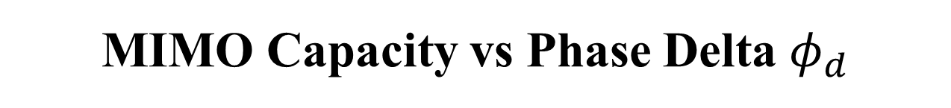
MIMO Capacity vs Phase Delta $φ_{d}$

Slide 9
Scenario 1: SVD Multiplexing (SM)
Phase delta=180deg (maximizes capacity)
K=0dB

Slide 10
Scenario 1: SVD Multiplexing (SM)
Phase delta=0deg (minimizes capacity)
K=0dB

Slide 11
Scenario 1: SVD Multiplexing (SM)
TX arrays spacing=15cm
RX arrays spacing=20cm
K=0dB
Short range (small # of elements)

Slide 12
Scenario 1: SVD Multiplexing (SM)
TX arrays spacing=15cm
RX arrays spacing=20cm
K=0dB
Long range (high # of elements)

Slide 13
Scenario 2: Multi-Array Beamforming (MAB)
Form a larger single array by phase-aligning the two arrays
Transport a single stream at higher SNR
  2 TX arrays and 2 RX arrays: 9dB higher total SNR compared to SISO case
RF TRX
RF TRX
1-stream Encoder
Multi-Array Beamforming
Multi-Array Beamforming
1-stream Decoder
RF TRX
RF TRX

Slide 14
Scenario 2: Multi-Array Beamforming (MAB)
Two example usage cases
9dB SNR gain compared to single array case (6dB from TX and 3dB from RX)
At low SNR, scheme 2 outperforms scheme 1 without waterfilling
LOS
Device
Device
Device
Device
Blocker
Reflector

Slide 15
SVD Multiplexing vs MAB
Multi-array beamforming (MAB) provides 9dB SNR gain compared to a single array case (6dB from TX and 3dB from RX)
At high SNR, SVD-M outperforms MAB in terms of capacity.
At low SNR, MAB outperforms “SVD-SP w/o waterfilling” (with substantial delta)
At low SNR, MAB outperforms “SVD-SP w waterfilling” (but with very marginal delta)
Multi-Array Beamforming (MAB) is simple to support from standard perspective (11ad nearly sufficient to support it).
  It is more of an implementation choice.

Slide 16
SVD Multiplexing vs MAB
SVD-Multiplexing can reach MAB performance at low SNR only with the help of waterfilling

Slide 17
Scenario 3: Spatial Aggregation (SA)
SVD can be eliminated if sufficiently separated beams can be identified.
Simplified TX and RX implementation
May be defined as a baseline MIMO mandatory mode (while making SVD-Multiplexing optional)
RF TRX
RF TRX
Optional Interference-Cancellation
2-stream Encoder
2-stream Decoder
RF TRX
RF TRX

Slide 18
Scenario 3: Spatial Aggregation (SA)
Example usage case
SA is a subset of SVD-Multiplexing
Use of interference cancellation in RX side is implementation and vendor choice.
Reflector
Device
Device
Blocker
Reflector

Slide 19
Scenario 4: Multi-Array Diversity (MAD)
Transport the same streams across two arrays.
A sub-optimal configuration to MAB when MAB is not applicable.
  SNR is low for significant gain out of SVD-SM
  Link reliability/redundancy is a key metric
  Cross-interference between the multiple beams is relatively high
3dB diversity/energy combining gain compared to a single array case.
RF TRX
RF TRX
Spatial Diversity Combining
1-stream Encoder
1-stream Decoder
RF TRX
RF TRX

Slide 20
Scenario 4: Multi-Array Diversity (MAD)
Example usage case
  Simple reliability improvement
  Energy combining gain
Reflector
Device
Blocker
Device
Reflector

Slide 21
Summary of MIMO Scenarios
Mode | Number of data streams (Constellation-Level) | True MIMO Coding | Improved Merit of Figure | Some applicable usages
SVD Multiplexing (SM) -Closed Loop using CSI | Two | Yes | Throughput | Backhaul capacity, adjacent arrays, high SNR, polarization multiplexing
Multi-Array Beamforming (MAB) | Single | No | SNR | Backhaul range, adjacent arrays, low SNR
Spatial Aggregation (SA) -Open Loop | Two | No | Throughput | Indoor/Outdoor, polarization multiplexing when good separation available
Multi-Array Diversity (MAD) | Single | No | SNR | Indoor, distant arrays

Slide 22
Phase Noise Impact on SVD Multiplexing
Phase noise seen by the multiple streams may only be partially correlated
  Cases that two different RFIC chips are deployed
An SVD-based multiplexing will experience cross-stream interference due to uncorrelated phase noise
  This effect is not seen in existing MIMO systems (such as 11ac where the same LO is feeding the multiple streams)
Simulation scenario:
  Low-frequency “correlated phase noise” and high-frequency “uncorrelated phase noise”
  Integrated phase noise (uncorrelated portion) of 5 deg (fairly pessimistic)

Slide 23
Phase Noise Impact on SVD Multiplexing
Integrated uncorrelated phase noise = 5deg

Slide 24
Summary
All four “multi-radio” scenarios can be implemented using a common PHY standard framework.
Possible standard framework:
  Ability to generate 2 to 4 independent streams (no cross coding)
    Enables two modes of operation: transport data streams over the same frequency channel (spatial aggregation) or over different frequency channels (carrier aggregation)
  Ability to apply some form of “SVD coding” to generate 2 to 4 coded data streams
  This “waveform generation” framework enables following usages: SVD multiplexing (LOS/AWGN MIMO), polarization multiplexing, multi-array beamforming, spatial aggregation, carrier aggregation, multi-array diversity.
 | Same channel | Different channels
No TX cross-coding | Spatial aggregation | Carrier aggregation
TX cross-coding | SVD multiplexing | N/A

