Slide 1
The original figures in the draft technical report on interworking between 3GPP 5G network and WLAN
Date: 2021-01-04
Authors:

Slide 2
Abstract
This is the figures regarding interworking reference model shown in IEEE 802.11 AANI contribution “Draft technical report on interworking between 3GPP 5G network and WLAN(IEEE 802.11-20/013r9)”.

Slide 3
Network Interface
3GPP 5G
Core Network
Wireless
Interface
Data
Network
Terminal
Access Network
Fig. 1 Overview of interworking reference model

Slide 4
UE
5G Access
5G Access Network
Network Interface
3GPP 5G
Core Network
3GPP
Access
3GPP Access
AMF
Data
Network
STA
WLAN Access
WLAN
Access
WLAN Access
Terminal
Fig. 2 Tightly coupled interworking reference model between 5G core network and WLAN

Slide 5
UE
5G Access
3GPP 5G Access Network
Network Interface
3GPP
5G Core
Network
3GPP
Access
AMF
Data
Network
STA
WLAN Access
WLAN
Access
N3IWF
WLAN Access Network
TNGF
Terminal
STA
WLAN
Access
Terminal
Fig. 3 Loosely coupled interworking reference model between 5G core network and WLAN

Slide 6
N1
N1
N15
UE
3GPP
Access
3GPP Access Network
N2
AMF
N11
SMF
N7
PCF
Access
NWu
N2
N4
STA
WLAN Access Network
R8
ANC
R9
N3IWF
UFP
TEC
N3
TEI
R1
WLAN Access Data Path
R3(Y2)
3GPP 5G
Core Network
Fig. 4 Untrusted WLAN interworking reference model with 5G core network

Slide 7
N1
N1
N15
UE
3GPP
Access
3GPP Access Network
N2
AMF
N11
SMF
N7
PCF
Access
NWt
N2
N4
STA
WLAN Access Network
R8
ANC
R9
TNGF
UFP
TEC
N3
TEI
R1
WLAN Access Data Path
R3(Ta)
3GPP 5G
Core Network
Fig. 5 Trusted WLAN interworking reference model with 5G core network

Slide 8
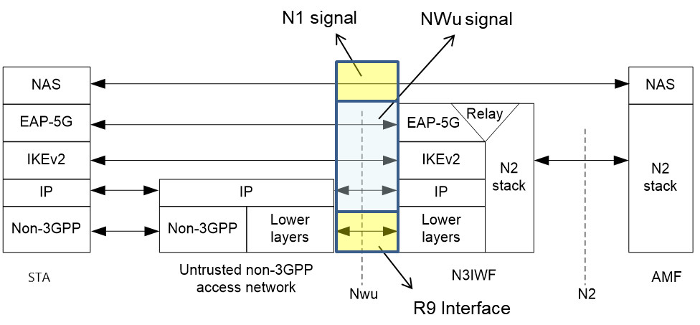
Fig. 6 Control plane between STA and N3IWF(3GPP TS 23.501)

Slide 9
WLAN Access Network
N3IWF
Ethernet protocol
Fig. 7 R3 interface

Slide 10
STA
WLAN Access Network
AMF/AUSF
N3IWF
IP address allocation
IKE-SA-INIT
IKE AUTH-Request
IKE AUTH-Response
IKE AUTH-Request/Response(EAP-5G)
N2 message
IKE AUTH-Request/Response(EAP-5G)
N2 message
IPsec SA completed
Fig. 8 NWu interface

Slide 11
WLAN Access Network
STA
N3IWF
AMF
IPsec SA is completed
NAS signaling
Fig. 9 N1 interface

Slide 12
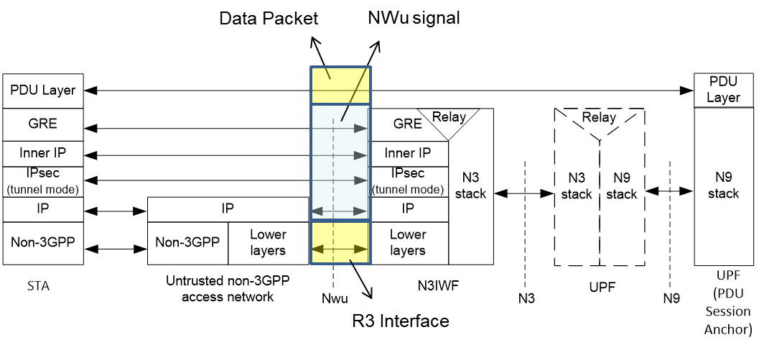
Fig. 10 Data plane between STA and N3IWF(3GPP TS 23.501)

Slide 13
N3IWF
SMF
QoS DRB
QoS Profile
Packet Scheduling
Packet Scheduling
Data rate
Latency
PER
Packet size
Data rate
Latency
PER
Packet size
STA
AP
TEI
WLAN Access Data Path
UPF
Wireless Access
3GPP 5G Core Network
Fig. 13 QoS mapping and scheduling example of WLAN

Slide 14
TSN Domain
TSN Domain
End Station
Master Station
TT
UE
5G AN
5G CN
TT
TSN Bridge
Fig. 14 TSN bridge using 5G AN and CN

Slide 15
TSN Domain
TSN Domain
End Station
Master Station
TT
STA
WLAN AN
5G CN
TT
TSN Bridge
Fig. 15 TSN bridge using WLAN and 5G CN interworking

Slide 16
TSN Domain
TSN Domain
End Station
Master Station
TT
STA
WLAN AN
TT
TSN Bridge
Fig. 16 TSN bridge using WLAN only

